Slide 1
Data Structures Lab 1 Topic: Arrays and Basic Operations
By Uzair Hassan

Slide 2
Objectives of Lab 1
Understand the concept of arrays in data structures
Learn basic operations on arrays: Insertion, Deletion, Searching
Implement an array and perform basic operations in code

Slide 3
What is an Array?
Definition: A collection of elements stored in contiguous memory locations.
Characteristics:
Fixed size
Elements of the same data type
Random access using index
Example: int arr[5] = {10, 20, 30, 40, 50};

Slide 4
Types of Arrays
One-Dimensional Array (1D): A simple array of elements.
Two-Dimensional Array (2D): A matrix, used to store data in rows and columns.
Multi-Dimensional Array: Arrays of more than two dimensions.

Slide 5
Basic Array Operations
Insertion: Add an element at a specific position.
Deletion: Remove an element from a specific position.
Access: Retrieve an element at a given index.
Search: Find the position of an element in the array.

Slide 6
Insertion in an Array
Procedure:
Shift elements to the right to make space for the new element.
Insert the new element at the desired position.
Update the size of the array.
Time Complexity: O(n) in the worst case (if inserted at the start).

Slide 7
Deletion in an Array
Procedure:
Identify the position of the element to delete.
Shift elements to the left to fill the gap.
Update the size of the array.
Time Complexity: O(n) in the worst case (if deleted from the start).

Slide 8
Search in an Array
Linear Search:
Traverse the array from the beginning until the element is found.
Time Complexity: O(n)
Binary Search (only for sorted arrays):
Divide the array into halves and search.
Time Complexity: O(log n)

Slide 9
Accessing an Array Element
Access an element using its index.
Example:
int arr[] = {10, 20, 30, 40, 50};
printf("%d", arr[2]); // Output: 30
Time Complexity: O(1)

Slide 10
Lab Task Overview
Create an Array: Initialize an array and store elements.
Perform Operations:
Insert an element at a specific position.
Delete an element from a specific position.
Search for an element in the array.
Print the array after each operation.
Tools/Language: Use C/C++/Java/Python to implement.

Slide 11
Pseudocode for Insertion
insert(arr, n, pos, value)
for i from n-1 to pos
arr[i+1] = arr[i]
arr[pos] = value
n = n + 1
Explanation: Shift elements to the right, insert the value at pos, and increase the size of the array.

Slide 12
Pseudocode for Deletion
delete(arr, n, pos)
for i from pos to n-1
arr[i] = arr[i+1]
n = n – 1
Explanation: Shift elements to the left to fill the gap left by the deleted element.

Slide 13
Pseudocode for Searching (Linear Search)
search(arr, n, key)
for i from 0 to n-1
if arr[i] == key
return i
return -1
Explanation: Traverse the array to find the key. If found, return its index; otherwise, return -1

Slide 14
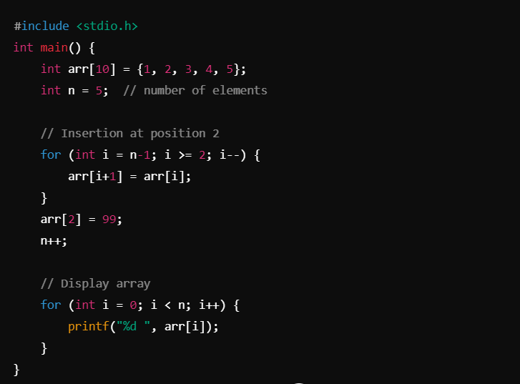
Sample Code for Array Operations (C)

Slide 15
Lab Exercise
Task 1: Create an array of size 10, initialize it with some values.
Task 2: Implement functions to:
Insert an element at a specific position.
Delete an element from a specific position.
Search for a given element.
Task 3: Test the array with different input values.

